Slide 1

AI Agents in SaaS
Exploring the efficiency and impact of AI agents on SaaS companies.

Slide 2

Introduction
This presentation explores the role of AI agents in improving the efficiency of Software as a Service (SaaS) companies. We will cover the definition and types of AI agents, their applications in the SaaS industry, and the efficiency gains they offer.

Slide 3
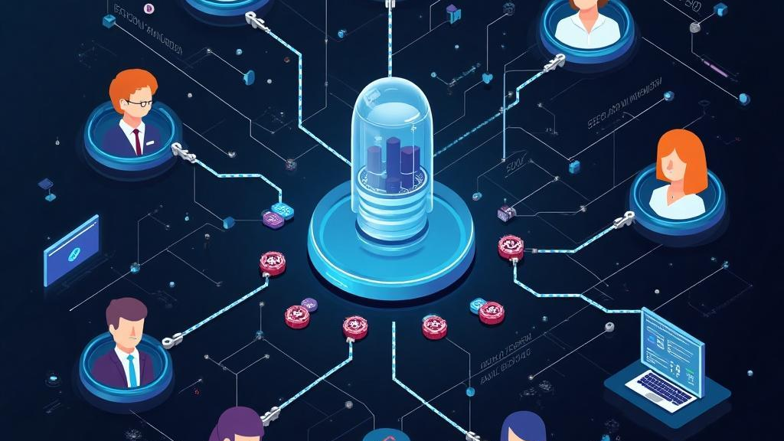
01
AI Agents Overview

Slide 4

Definition and Purpose
AI agents are software programs that utilize artificial intelligence to perform tasks autonomously or semi-autonomously. Their primary purpose is to assist businesses by increasing productivity, reducing operational costs, and enhancing user experiences.

Slide 5
Types of AI Agents
There are various types of AI agents, including:
1. **Chatbots**: Interactive agents that communicate with users via text or voice.
2. **Virtual Assistants**: Personalized agents that automate tasks and provide recommendations.
3. **Predictive Analytics Tools**: AI systems that analyze data to forecast trends and behaviors.

Slide 6
Applications in SaaS
AI agents are widely applied in SaaS companies for:
1. **Customer Support**: Providing 24/7 assistance, resolving issues, and answering FAQs.
2. **Sales and Marketing**: Automating lead generation and targeting specific audiences.
3. **Data Management**: Streamlining data entry tasks and ensuring data accuracy.

Slide 7

02
Efficiency Gains

Slide 8
Improved Customer Support
AI agents significantly enhance customer support by providing immediate responses, reducing wait times, and handling multiple inquiries simultaneously. This leads to increased customer satisfaction and loyalty.

Slide 9

Automation of Processes
By automating routine tasks such as data entry, scheduling, and follow-ups, AI agents free up human resources, allowing teams to focus on more strategic initiatives, thereby increasing overall productivity.

Slide 10
Enhanced Decision Making
AI agents assist in decision-making by analyzing large volumes of data quickly and accurately. They can identify patterns and trends that human analysts may overlook, thus providing valuable insights that inform strategic business decisions. This leads to improved alignment with market needs and enhances competitive advantage.

Slide 11

03
Integration Challenges

Slide 12

Technical Compatibility
Integrating AI agents with existing SaaS platforms can pose technical challenges. Companies must ensure that AI solutions are compatible with their current software infrastructure and can seamlessly communicate with other tools and systems to avoid operational disruption.

Slide 13
Data Privacy Issues
The integration of AI agents raises significant data privacy and security concerns. SaaS companies must navigate compliance with regulations such as GDPR and ensure that AI systems handle sensitive customer data responsibly to maintain trust and avoid legal repercussions.

Slide 14
User Adoption
For AI agents to be effective, user adoption is crucial. SaaS companies may face resistance from employees who are accustomed to traditional methods. Comprehensive training and clear communication about the benefits of AI integration are essential to foster acceptance and utilization.

Slide 15

04
Future Trends

Slide 16

AI Innovations
The rapid evolution of AI technology brings continuous innovations, such as natural language processing enhancements and machine learning advancements. These innovations will enable AI agents to become even more sophisticated, responsive, and capable of handling complex tasks across various business functions.

Slide 17
Increasing Role in Business
As AI technology matures, its role within organizations is expected to grow. Businesses will increasingly rely on AI agents for insights, automation, and improving customer experiences, positioning AI as a vital component of business strategy in SaaS.

Slide 18
Implications for SaaS Companies
The shift towards AI integration will have profound implications for SaaS companies, including the need for ongoing training, infrastructure investment, and a cultural shift towards embracing technology. Companies that successfully navigate these changes will gain a competitive edge in the dynamic market.

Slide 19

Conclusions
In summary, AI agents present significant opportunities and challenges for SaaS companies. By enhancing efficiency in customer support, decision-making, and process automation, they can drive growth. However, successful integration requires addressing technical compatibility, privacy concerns, and fostering user acceptance.

Slide 20
Thank you!
Do you have any questions?
+91 620 421 838

